Slide 1

Rhythm Revisited
Year 7

Slide 2
Why?
Rhythm is a very important MAD T-SHIRTS element!
Increase our confidence with reading and performing different rhythms.
Develop our group working skills.

Slide 3
Whiteboard warm-up (work silently and by yourself)
1. Fill in the gaps
- Pulse in music is the s_ _ _ _ _ b_ _ _ .
- Rhythm is a p_ _ _ _ _ _ of l_ _ _ and s_ _ _ _ sounds. An example is: (notate your own example).
2. What would you like to know about rhythm?
Notes:
Pulse in music is the steady beat.
Rhythm is a pattern of long and short sounds.

Slide 4
What’s in the basket?
Question
+
Answer
=
Call and response
Notes:
Start by speaking answers, then speaking and clapping and then just clapping. Get students to work in a small group to put their basket contents together.

Slide 5
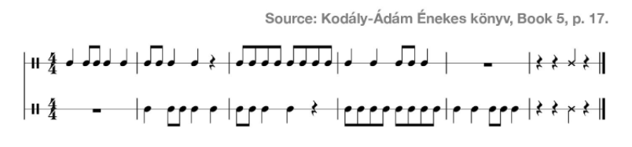
Bonus box:
What’s the time signature? Does it matter?
Notes:
Get class to perform on djembes and then discuss texture (canon)

Slide 6
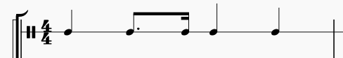
What’s in the basket?
Notes:
Use this slide to discuss dotted rhythms – what they mean, how they add up, what they sound like (Kodaly = tim-ri)

Slide 7
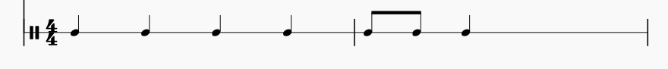
To finish
Bonus box:
How creative can you be?
Complete the rhythm (make sure it adds up correctly)

Slide 8
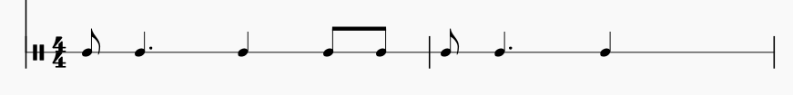
To finish
Bonus box:
How creative can you be?
Complete the rhythms (make sure they add up correctly)
Notes:
Do the 1st one together then 2nd one independently. Students to work on whiteboards.
If time/needed do popocatapetal again and do in a canon. Or sing There a river flowing in my hear

Slide 9
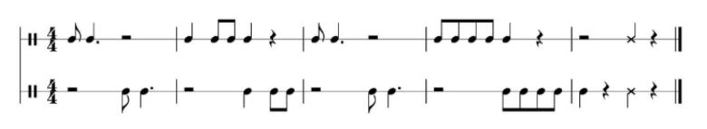
Notes:
Get students to recognize call and response/imitation (dotted rhythm Kodaly = ti tae)

Slide 10
Lesson 2

Slide 11
Paper warm-up You can talk to your neighbour
Write the correct lyrics under the rhythm.
Hint: speak the lyrics and work out how many syllables there are.
Bonus box:
Underneath, make up new lyrics and write down the rhythm too!

Slide 12
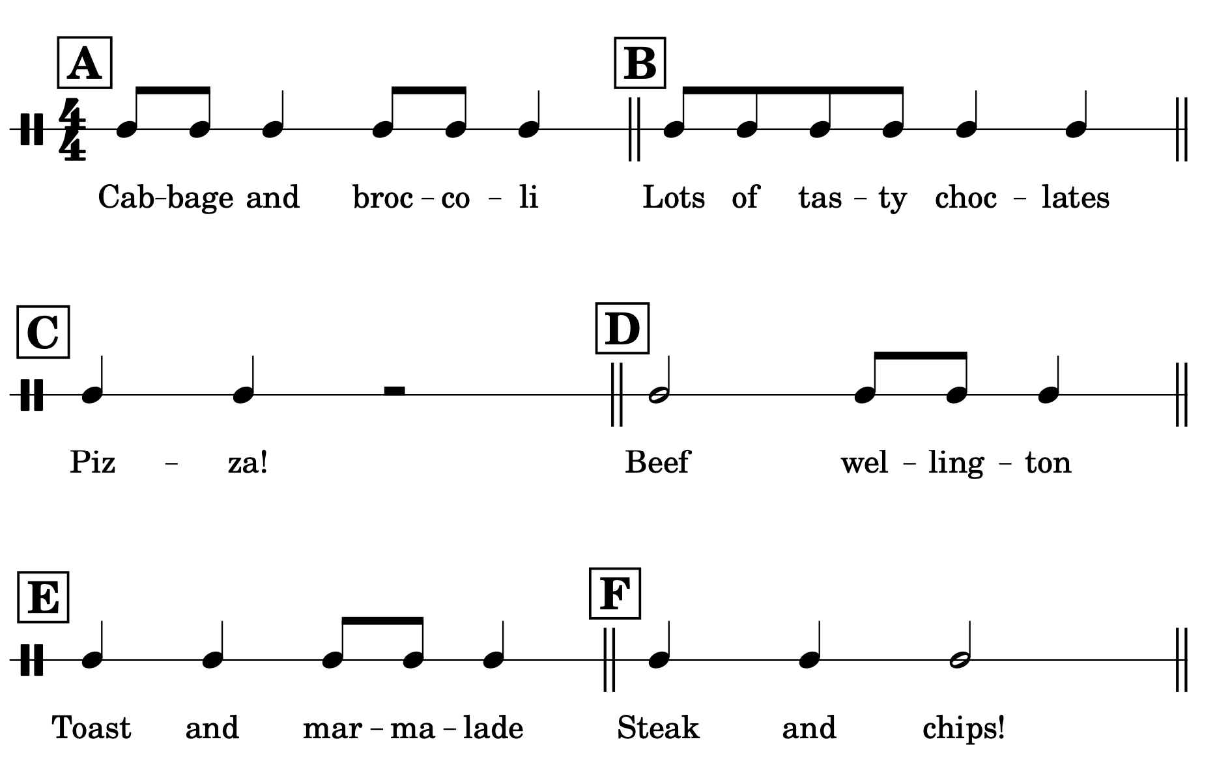

Slide 13
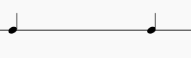
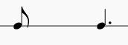
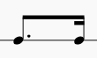
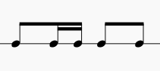
Paper warm-up 2 Complete in silence and by yourself
Turn the paper over. Add up the rhythms and write the total value.
=
Feeling stuck?
♩ Crotchet = 1
♪ Quaver = ½
♬Semiquaver = ¼
Dots add half the value of the note e.g. dotted crotchet = 1+1/2
1.
2.
=
3.
=
Bonus box:
Make up your own question. Go on, make it really tricky for me!
4.
=

Slide 14
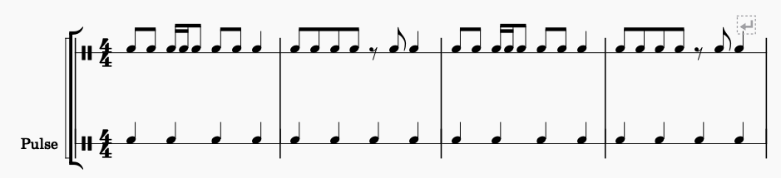
Notes:
Ask what label is missing (rhythm). Get them to work out repetition. Point out syncopation/explain main focus of the lesson.

Slide 15
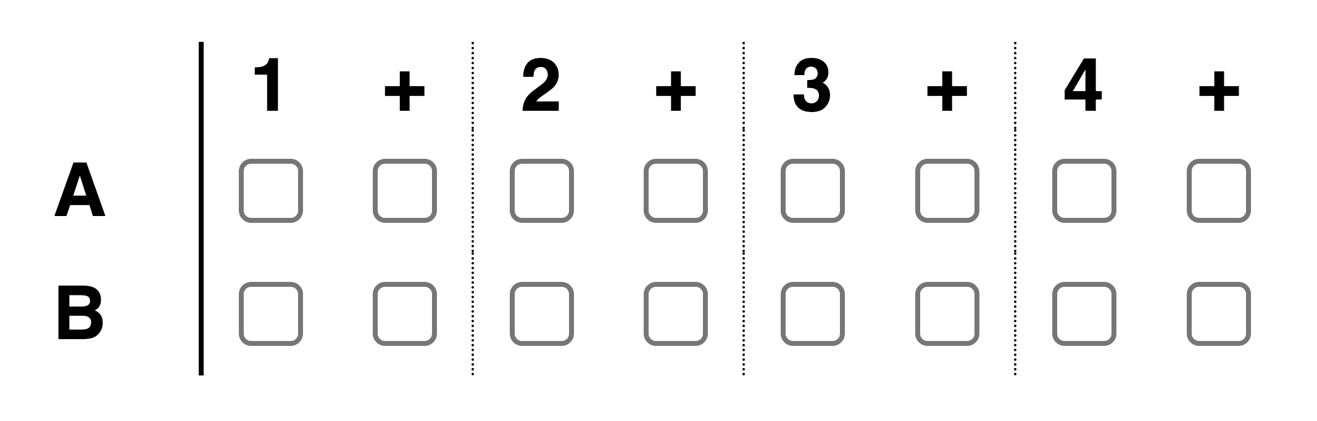

Slide 16
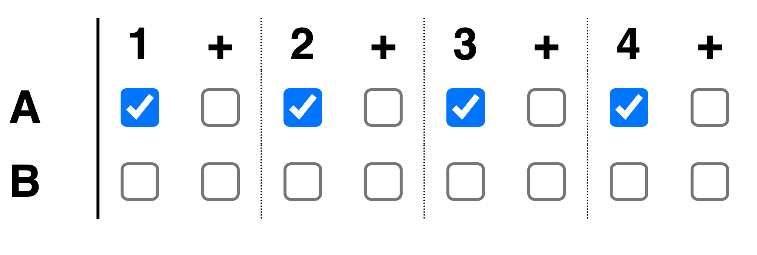
On-beats

Slide 17
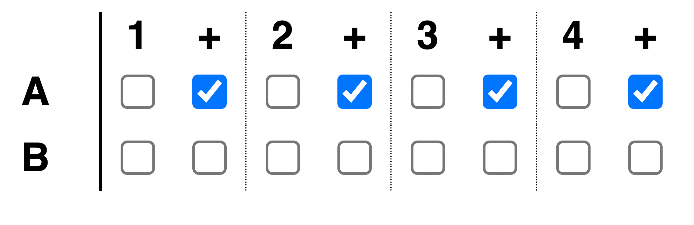
Off-beats

Slide 18
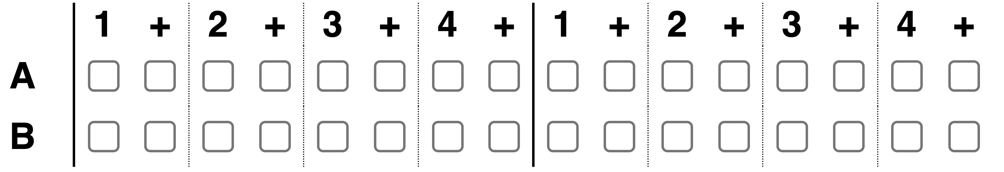
Syncopation = off-beats used more than on-beats

Slide 19
Syncopation = off-beats used more than on-beats
https://musiclab.chromeexperiments.com/Song-Maker/song/6593431611244544

Slide 21
Tutorials
Video 1
Video 2
Video 3
Video 4
Video 5

Slide 22
When I’m gone
I got my ticket for the long way ‘round
Two bottle o’ whisky for the way
And I sure would like some sweet company
And I’m leaving tomorrow, what do you say?
When I’m gone, when I’m gone
You’re gonna miss me when I’m gone
You’re gonna miss me by my hair
You’re gonna miss me everywhere, oh
You’re gonna miss me when I’m gone
Notes:
Students to stand and sing

Slide 23
Quartet
https://www.youtube.com/watch?v=6y1aOg_UO_A

Slide 24
Lesson recap Tell your neighbour the answer
Rhythm helps your t _ _ h _ _ _ m _ _ _
Rhythm is a p _ _ _ _ _ _ of l _ _ _ and s _ _ _ _ _ sounds.
Syncopated rhythms use more _ _ _ - _ _ _ _ _ than _ _ - _ _ _ _ _
A dotted note is worth _ _ _ %

Slide 25
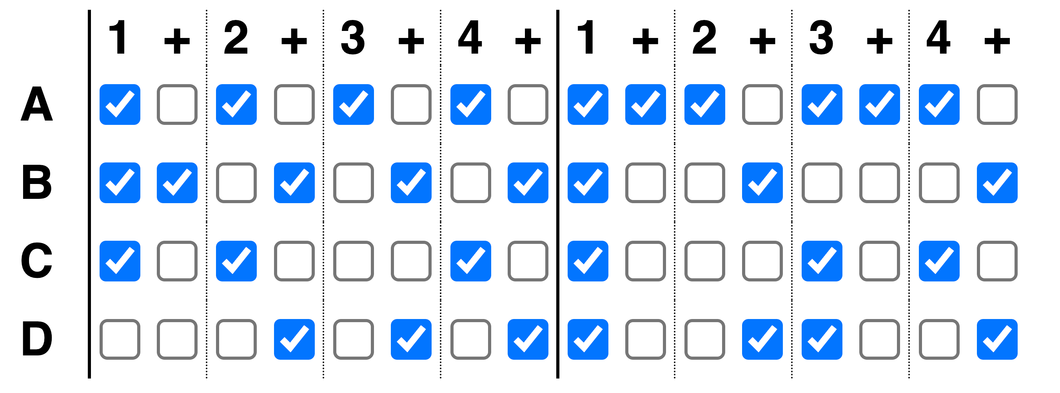
Which rhythms are syncopated?

Slide 26
Lesson 3

Slide 27
Whiteboard warm-up (work silently and by yourself)
Rhythm grid dictation. Start by copying this on your whiteboard:
1 | and | 2 | and | 3 | and | 4 | and
You will hear each rhythm 3 times and there will be a 4-beat pulse as an introduction before each rhythm starts.
Bonus box:
Write the time signature in and re-write the grid using rhythmic dictation (like crotchets and quavers etc).
Notes:
Rhythm 1= 1+2+3 4+
Rhythm 2 = 1+ 3+4+
Rhythm 3 = + + + +

Slide 28
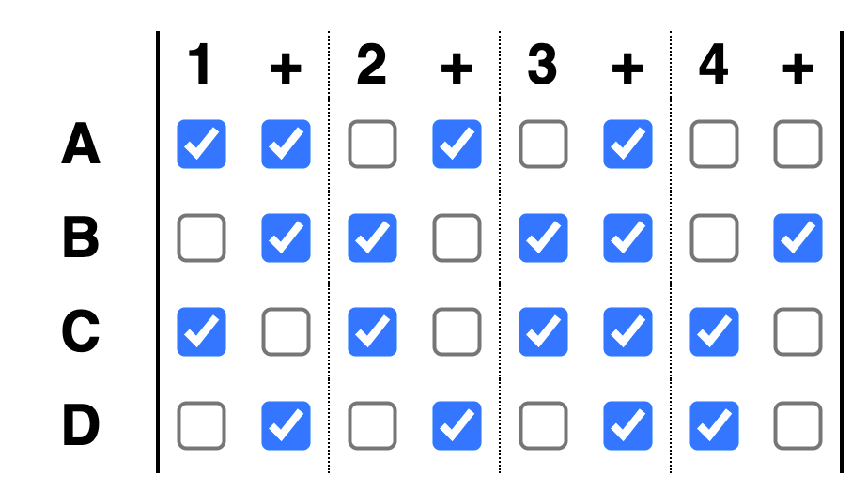
Last Lesson Rewind: Which rhythms are syncopated?

Slide 29
This snare drum rhythm starts syncopated. Write a second bar that uses straight rhythms instead.
https://musiclab.chromeexperiments.com/Song-Maker/song/6517621248360448

Slide 30
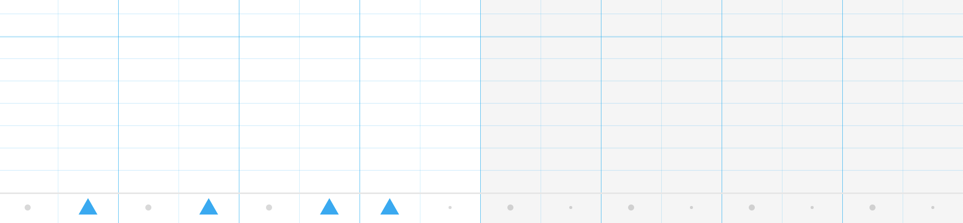
Snare drum = triangle. The first bar of the triangle rhythm is syncopated. Write a second bar that uses straight rhythms instead.

Slide 31
When I’m gone
I got my ticket for the long way ‘round
Two bottle o’ whisky for the way
And I sure would like some sweet company
And I’m leaving tomorrow, what do you say?
When I’m gone, when I’m gone
You’re gonna miss me when I’m gone
You’re gonna miss me by my hair
You’re gonna miss me everywhere, oh
You’re gonna miss me when I’m gone
Notes:
Students to stand and sing

Slide 32
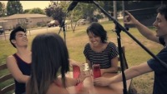
Notes:
Get students to comment on voices and cup rhythm – noticing movement and change in the middle.
Explain that students are going to put the rhythm together in small groups.

Slide 33








Working together well
What does successful group work look like?
What can you do if there is a problem?
Notes:
Ask students if they recognize the skills builder picture (1 of the 8 characteristics).
Discuss ideas.

Slide 34
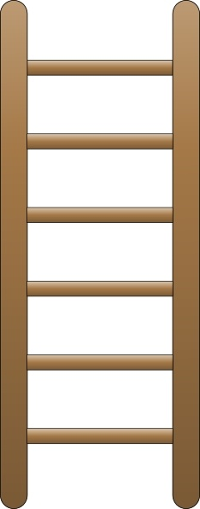
Cup song group work challenge
The group can add in a section where they produce the rhythm using different movements.
The group can swap/pass their cups around in a circle.
Everyone can perform the rhythm together, keeping to the same pulse.

Slide 35
Lesson 4
Notes:
No chairs

Slide 36
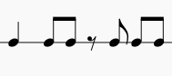
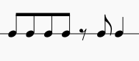
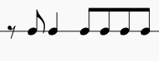
Whiteboard warm-up (work silently and by yourself)
Which rhythm am I clapping? Write the number on your whiteboard.
1.
2.
3.
Cup song
Which rhythm is the missing rhythm?
Notes:
After warm up, do cup song rhythm.

Slide 37
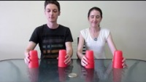
How can you make percussive sounds?
Notes:
Then demo with rhythm. On beat = 1, 2, 3. Off beat = take inspiration from ABBA’s ”dancing queen”

Slide 38
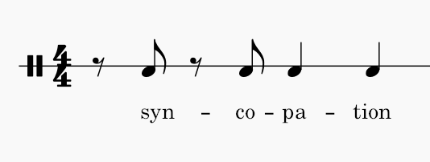
Notes:
Clap rhythm then get students to decide on cup percussion

Slide 39

Cups group work challenge #2
The Task = Use the starting syncopated rhythm, create your own group cup rhythm
It must be 8 beats long (same length as the original), make use of a range of different percussive sounds and involve your whole group.
Think about how your performance is going to start and end – will someone count in? Will you all play together or layer up one at a time? Can you manage any cup swapping?

Slide 40
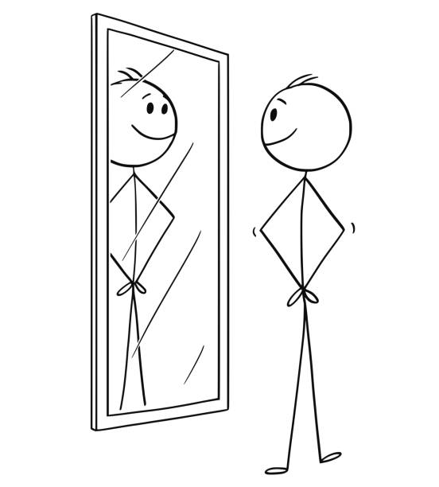
Working together well
…REFLECTION
What does successful group work look like?
What can you do if there is a problem?

Slide 41

Fun with rhythm
‘Chili con carne’ performed by The Real Group
Stand up or sit down every time you hear “chili con carne”
Find the pulse
Is this song mostly syncopated or on the beat?

Slide 42
Lesson 5

Slide 43
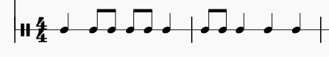
Whiteboard warm-up (work silently and by yourself)
Copy this rhythm on your whiteboard.
Listen and then write down the missing rhythm (where there is a ?)
?
Bonus: what other rhythms could fill that gap?
Notes:
quavers

Slide 44
Today’s lesson
We are going to be playing two short musical examples on xylophones to revisit something else to do with rhythm

Slide 45
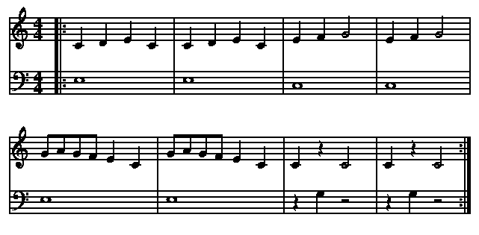
Title?
Bonus:
Notes:
Frere Jacques

Slide 46
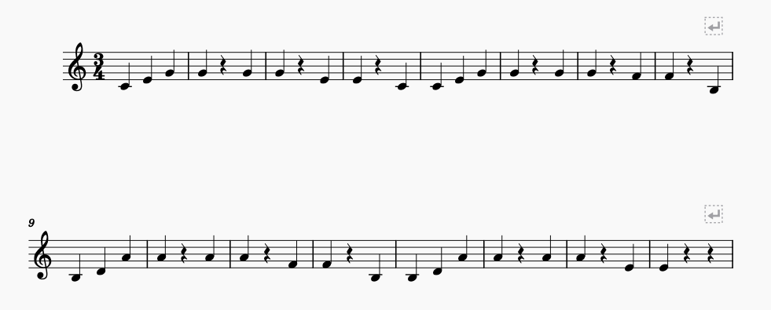
The Blue Danube
Notes:
Ask why have I chosen these two piece? Discuss time signature.

Slide 47
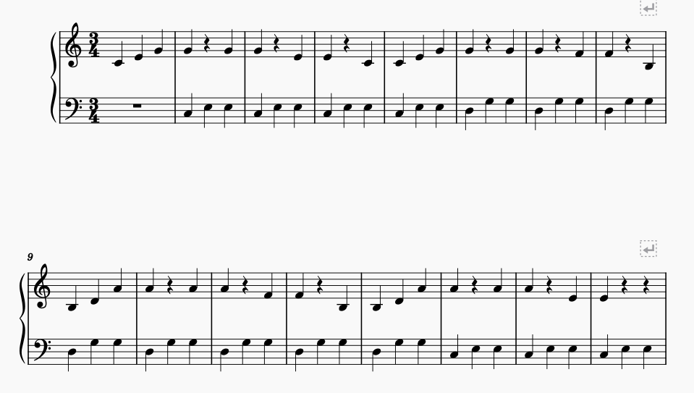
The Blue Danube
Bonus
Notes:
Print this for bonus

Slide 48
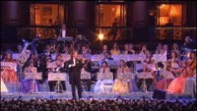

Slide 49
3/4 or 4/4
1.
2.
3.
4.
Notes:
¾
4/4
4/4
3/4

Slide 50
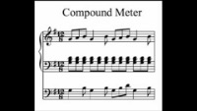
Notes:
Don’t show, just play music. Ask students to find the pulse. Then stand up and change direction when the music feels different. Then clap and tap out 4/4 vs 12/8.

Slide 51
Lesson 6

Slide 52
3/4 or 4/4
1.
2.
3.
4.
Notes:
Do as warm up. Ask for what a time signature is. Where do you see it on your music (point to poster).
¾
4/4
4/4
3/4

Slide 53
When I’m gone
I got my ticket for the long way ‘round
Two bottle o’ whisky for the way
And I sure would like some sweet company
And I’m leaving tomorrow, what do you say?
When I’m gone, when I’m gone
You’re gonna miss me when I’m gone
You’re gonna miss me by my hair
You’re gonna miss me everywhere, oh
You’re gonna miss me when I’m gone
Notes:
Singing, texture discussion and note reading.

Slide 54
Listening Test
Have a pen or pencil ready. Remember to write neatly.
You will hear the extract played twice.

Slide 55
Working together well
1) I will give you a rhythmic note to write on your board.
2) You can choose whether you are going to have one or two of your rhythms written down.
3) You can choose whether you are going to turn your rhythm into a rest (of the same value).
4) We will move sensibly around the room making 4/4 rhythms.
Notes:
Use for spontaneous rhythm making (give students crotchet, minim, quaver they draw that on whiteboard, then get into groups to make rhythms. Mix it around/find a good combination. Add syncopation?) Perform using varied body percussion sounds.

